Slide 1
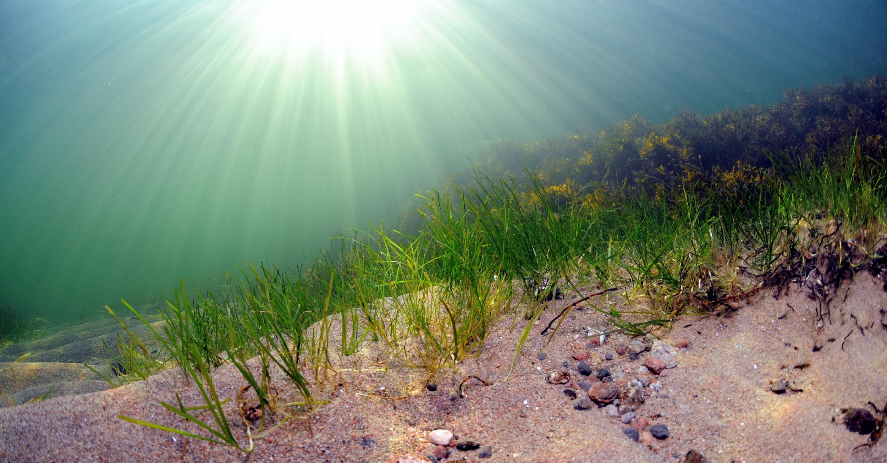
FUNCTIONAL COASTAL ECOLOGY 3sp
8-12.9 2025
TVÄRMINNE ZOOLOGICAL STATION,
UNIVERSITY OF HELSINKI

Slide 2
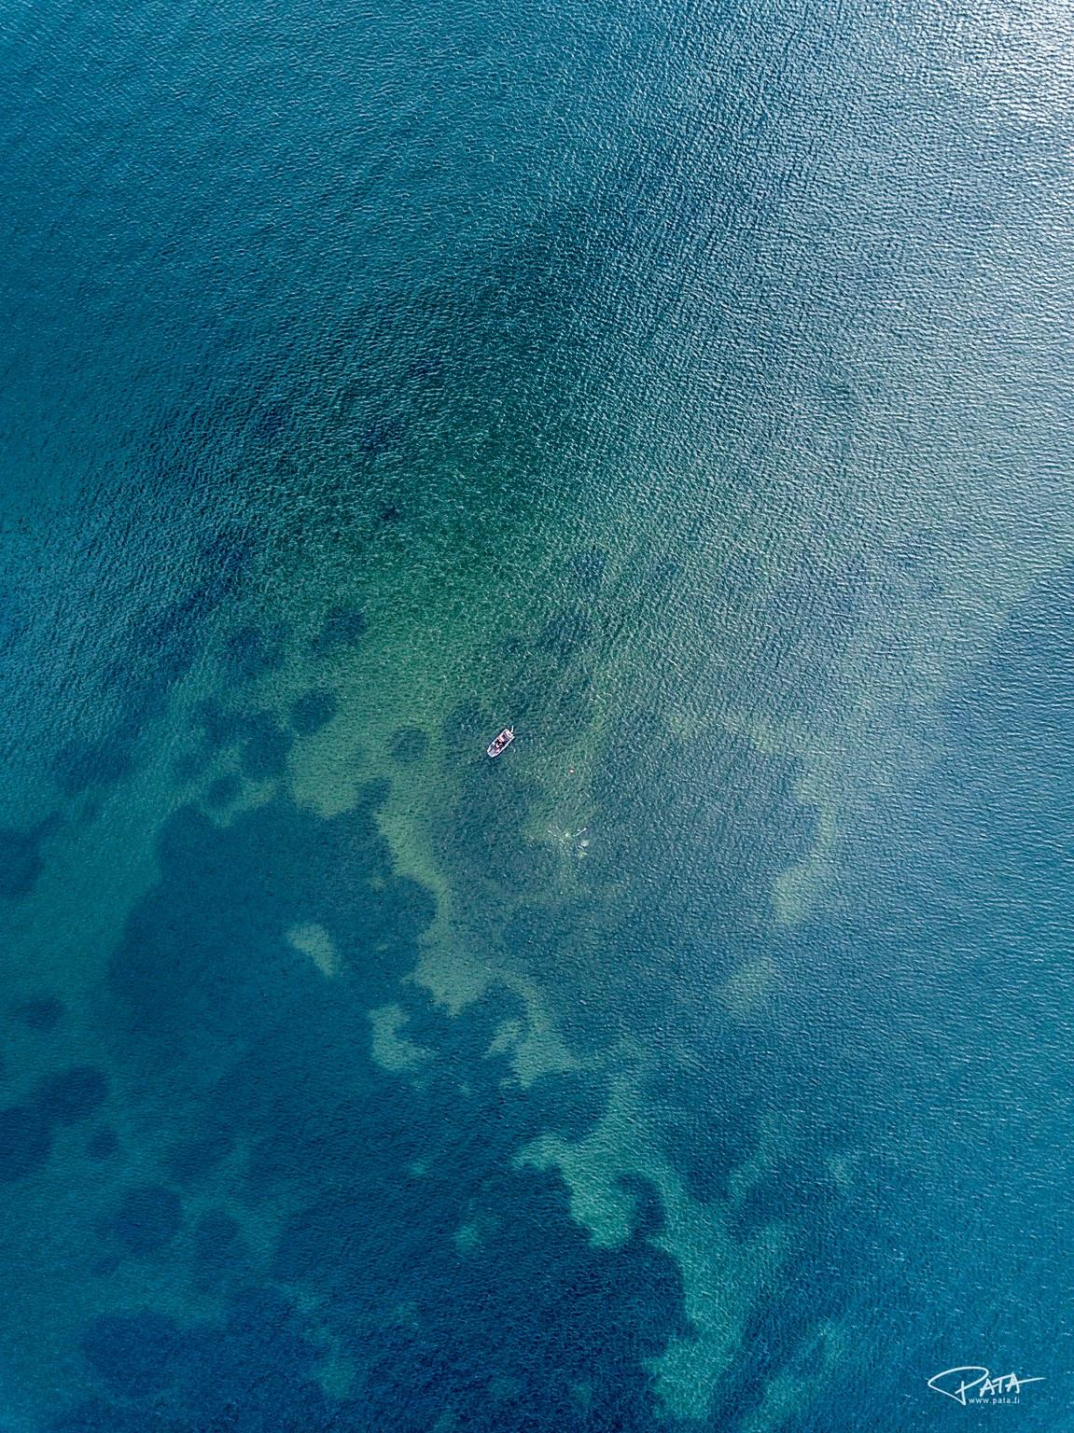
HEALTHY OCEANS MATTER
Marine coastal ecosystems play an important role in the fight against climate change. Healthy oceans holds the solutions to many of the world’s challenges.
Marine life in the Baltic Sea is facing a new situation due to changes in the environment.
During this course, you will gain an in-depth understanding of how marine biodiversity interacts with the carbon cycle.
The course is a five-day practical field course at the Tvärminne Zoological Station situated by the Baltic Sea.
During the course you will get acquainted with marine research at the station. You will learn how to carry out scientific sampling and analyses and learn to work in a scientific way.
If you want to get a better understanding of the marine life in the Baltic Sea, then this is the course for you!

Slide 3
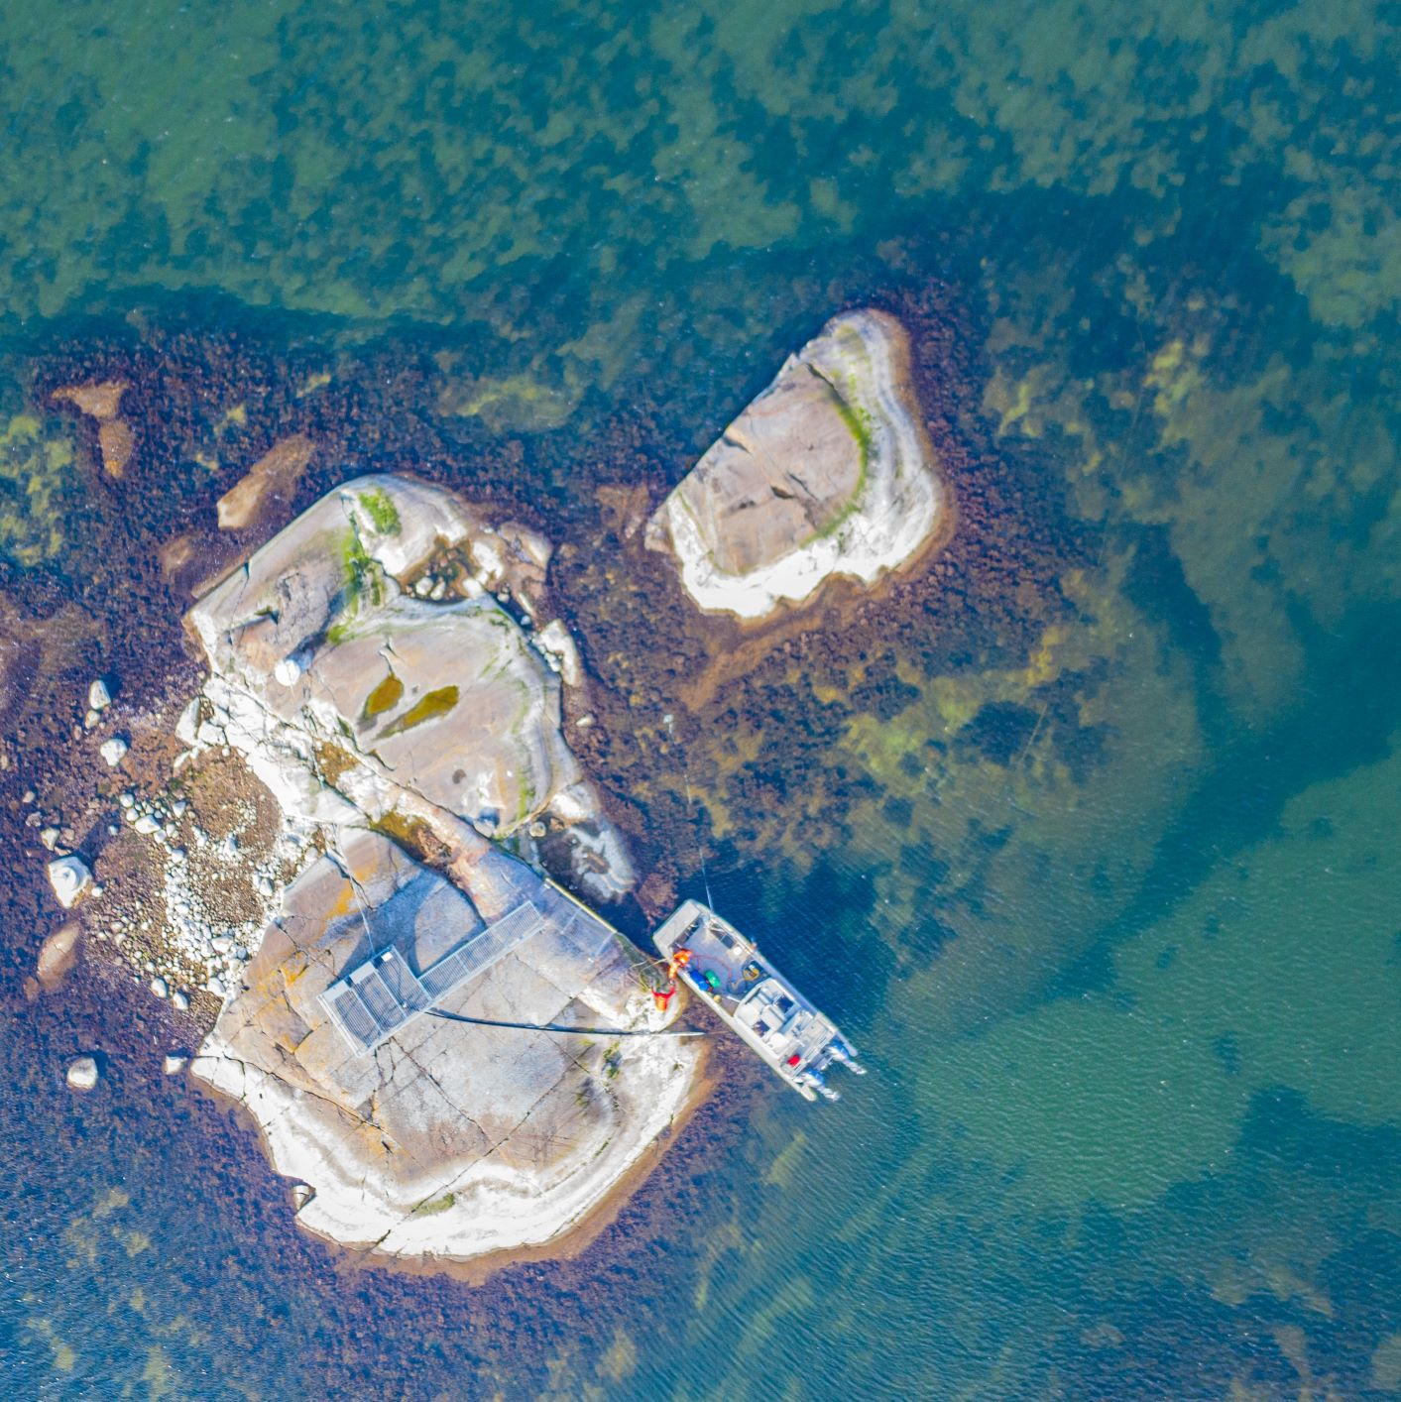
CUTTING EGDE SCIENCE AT TVÄRMINNE.
The CoastClim Research Centre at Tvärminne Zoological Station explores the capacity of coastal ecosystems to mitigate climate change.
The aim is to test whether healthy coastal ecosystems of the Baltic Sea can act as carbon sinks and have a positive effect on the climate.
In contrast, degraded coastal ecosystems could emit large amounts of greenhouse gases and accelerate climate change.

Slide 4
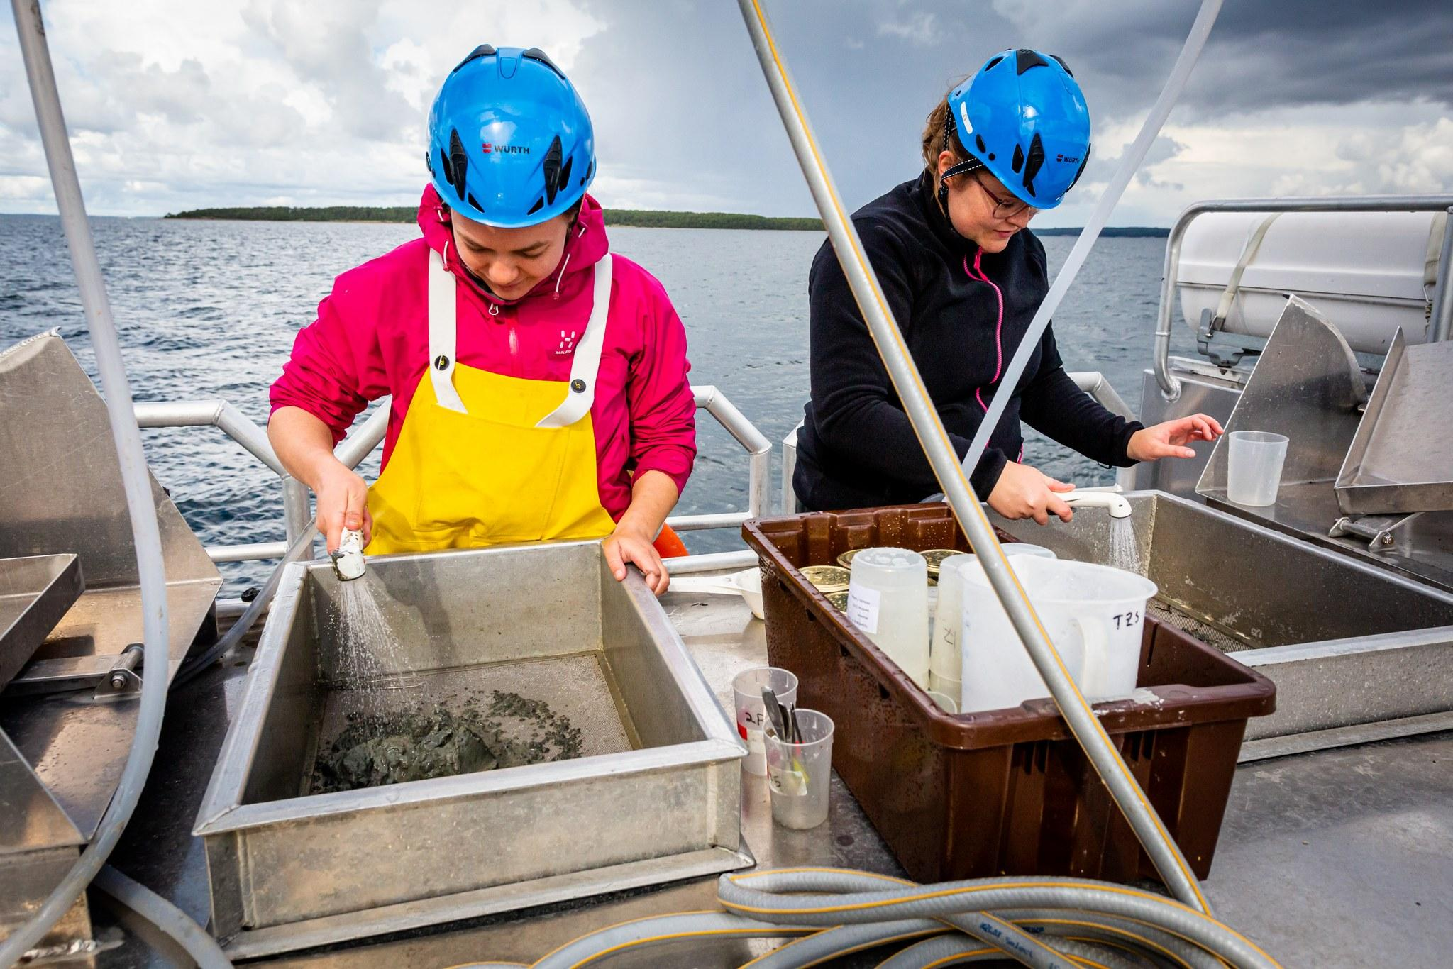
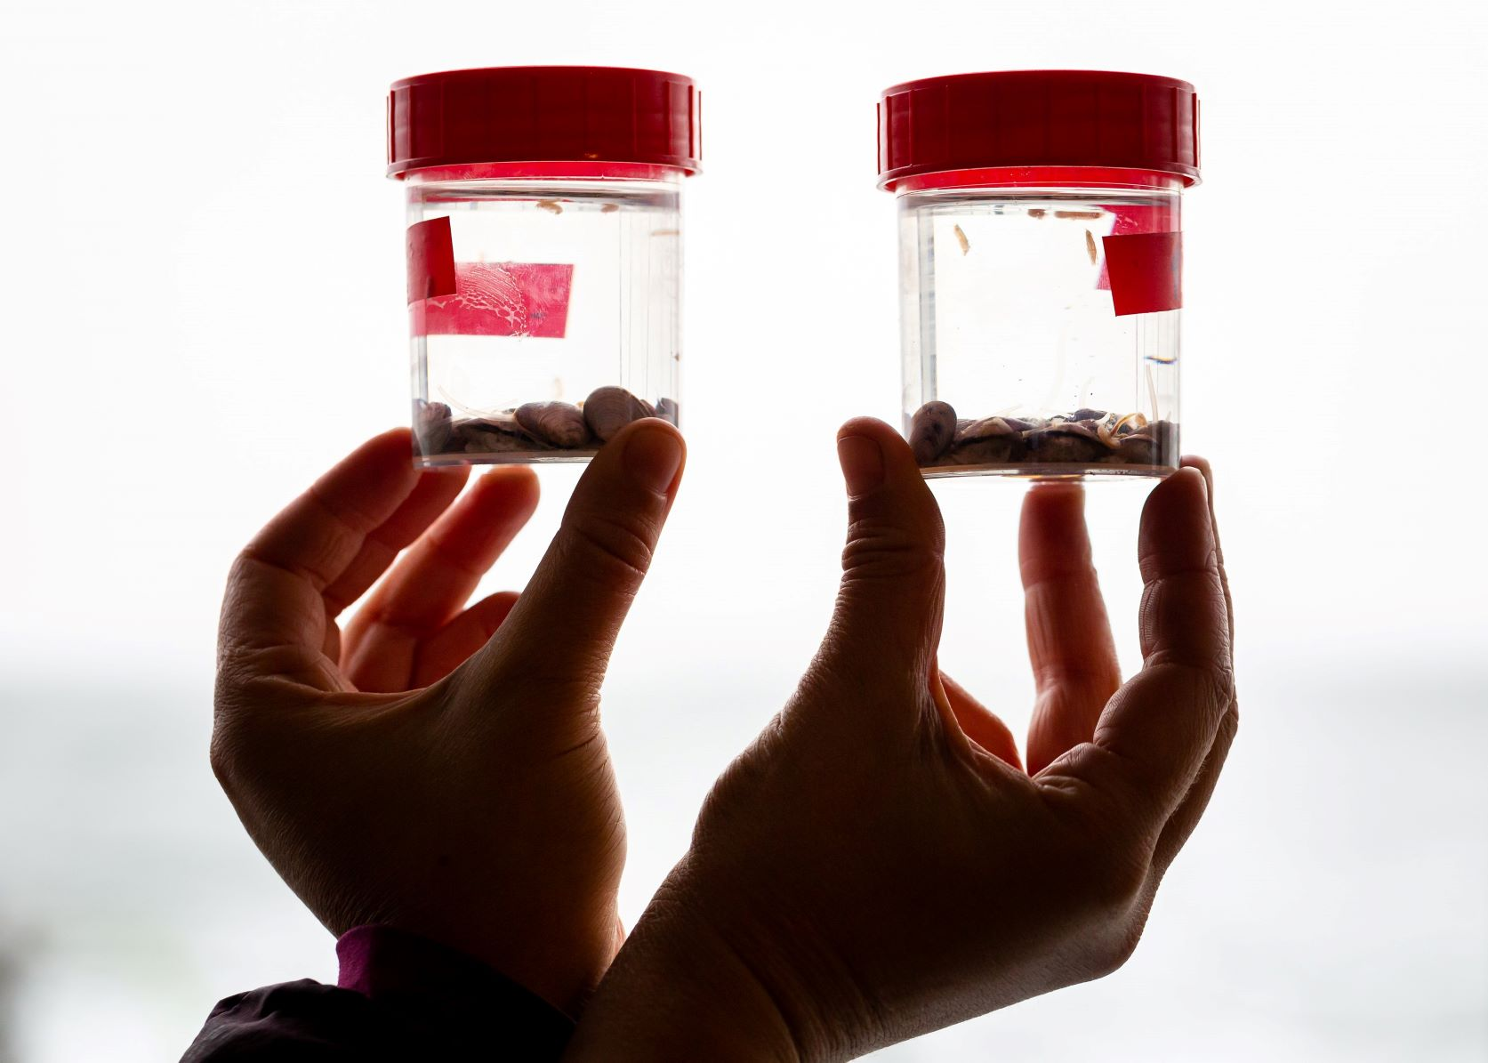
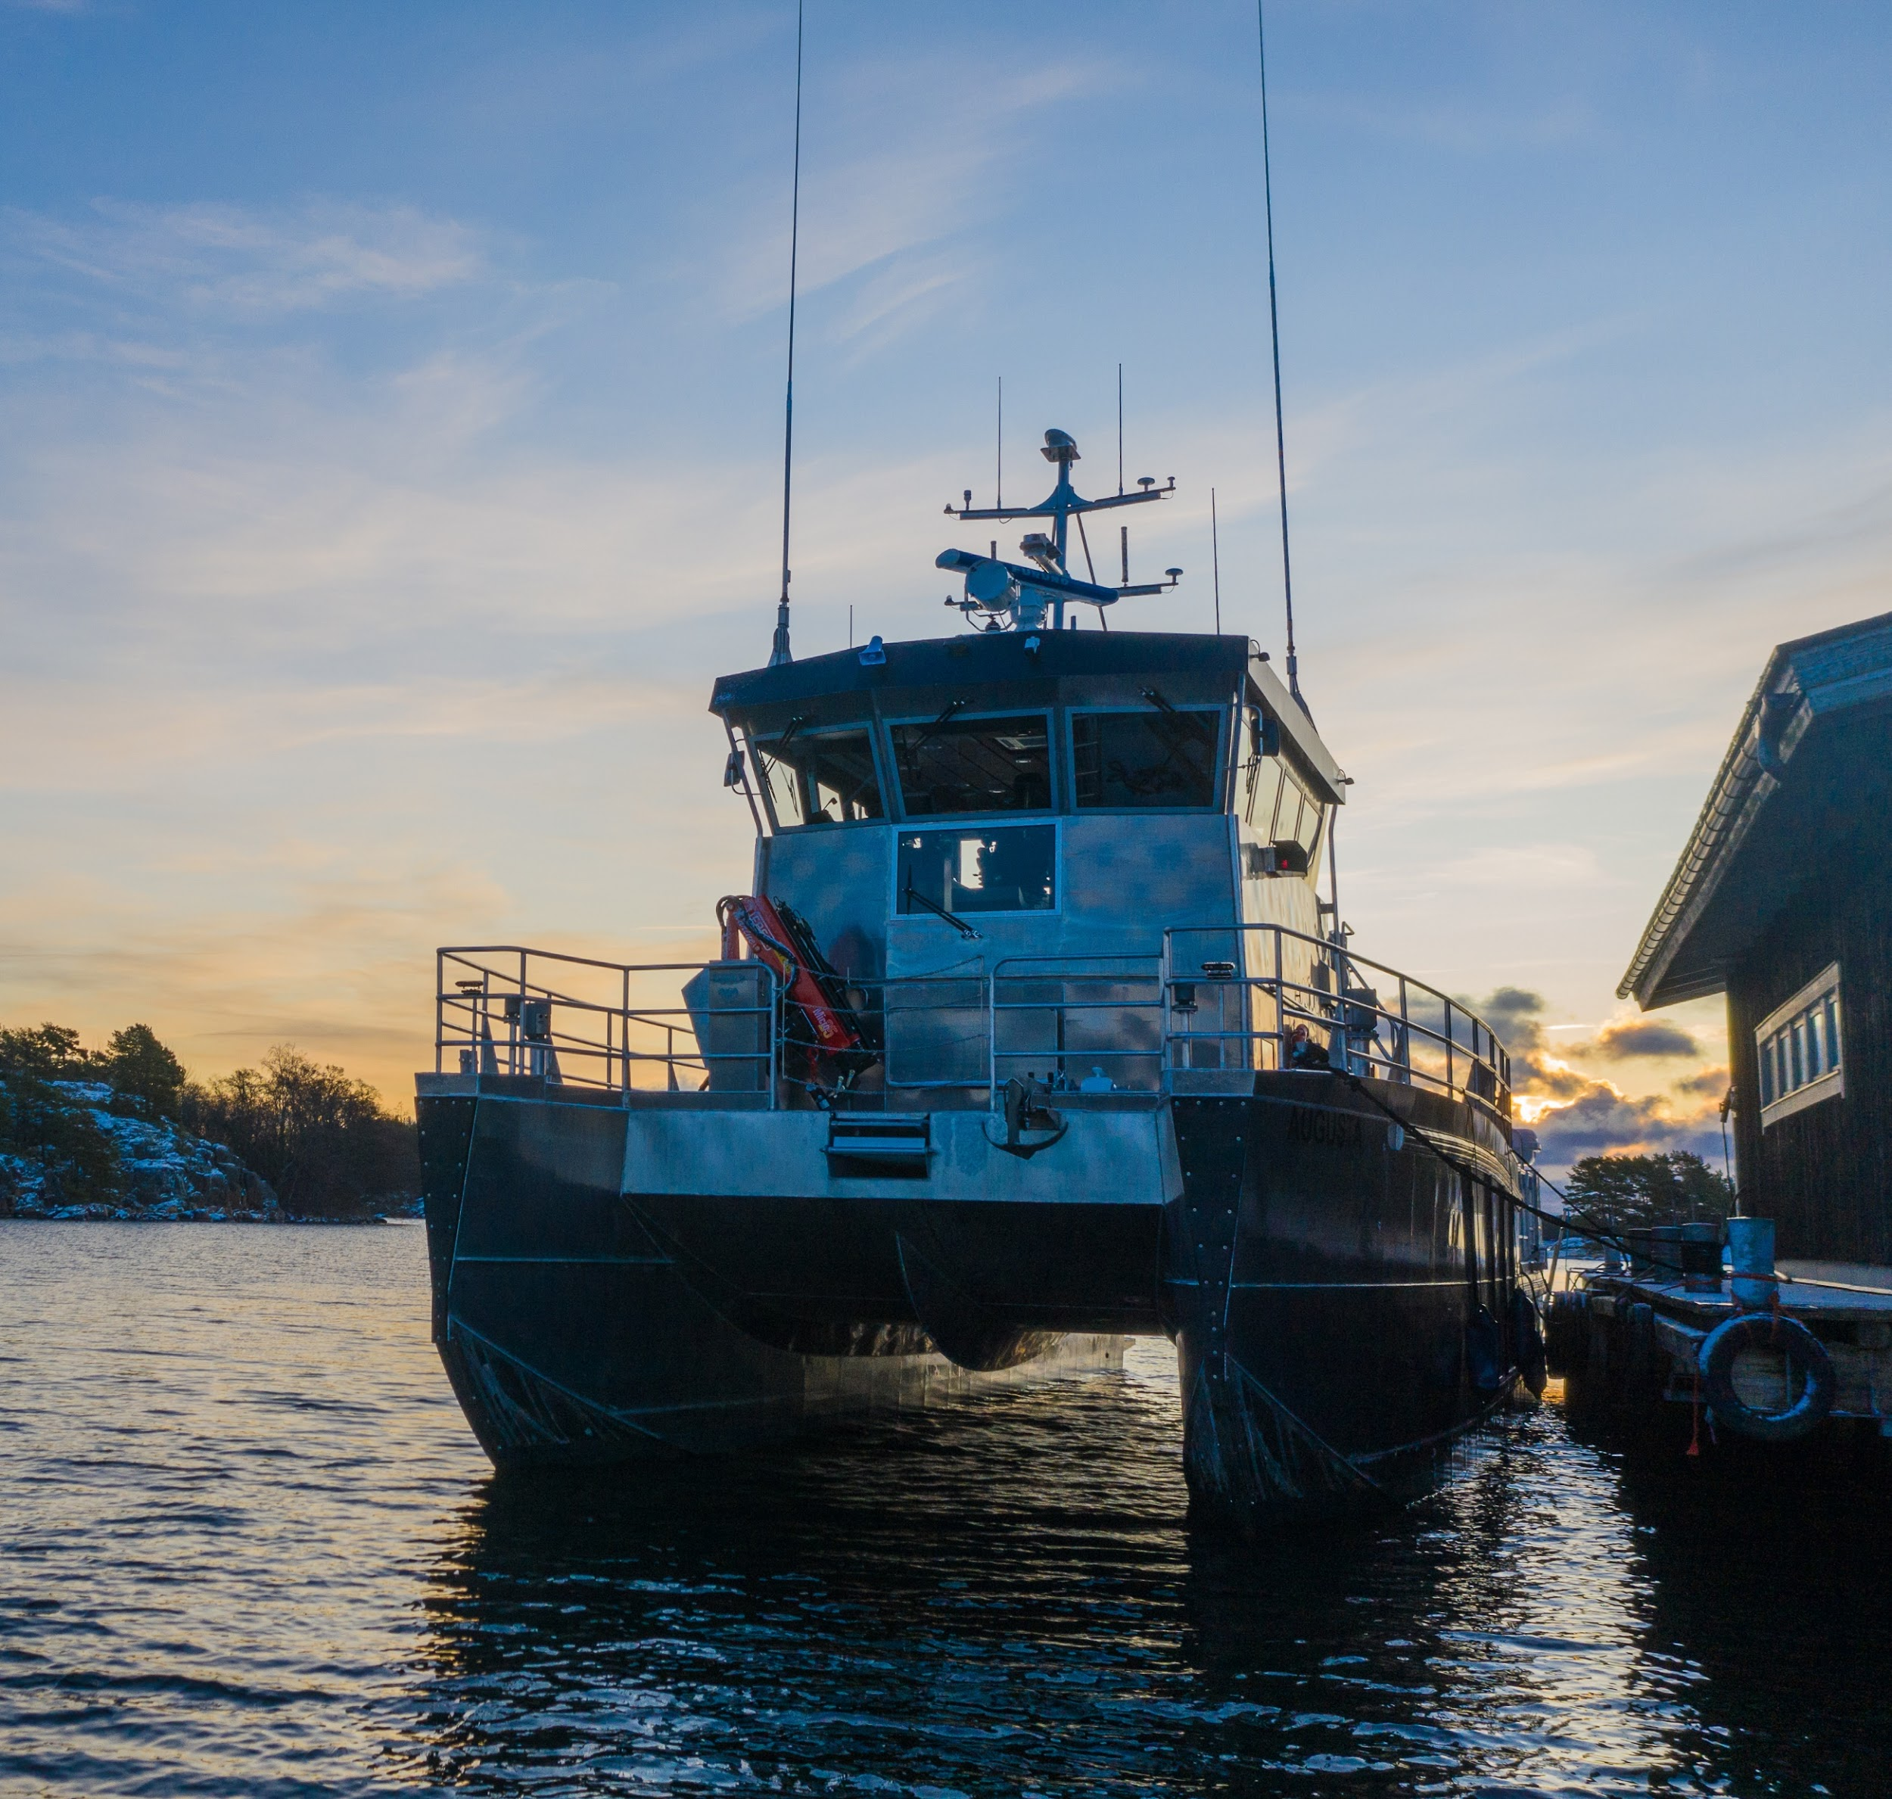
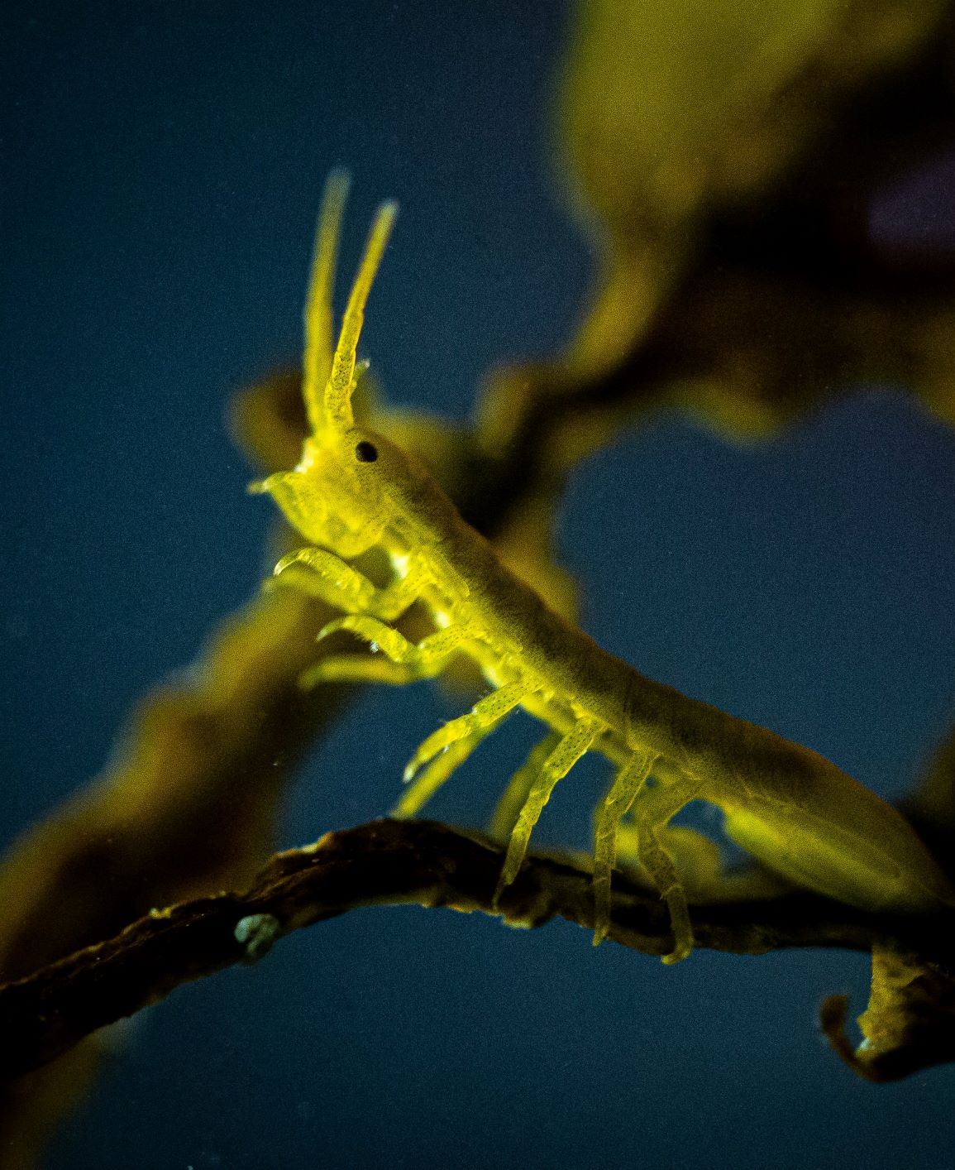
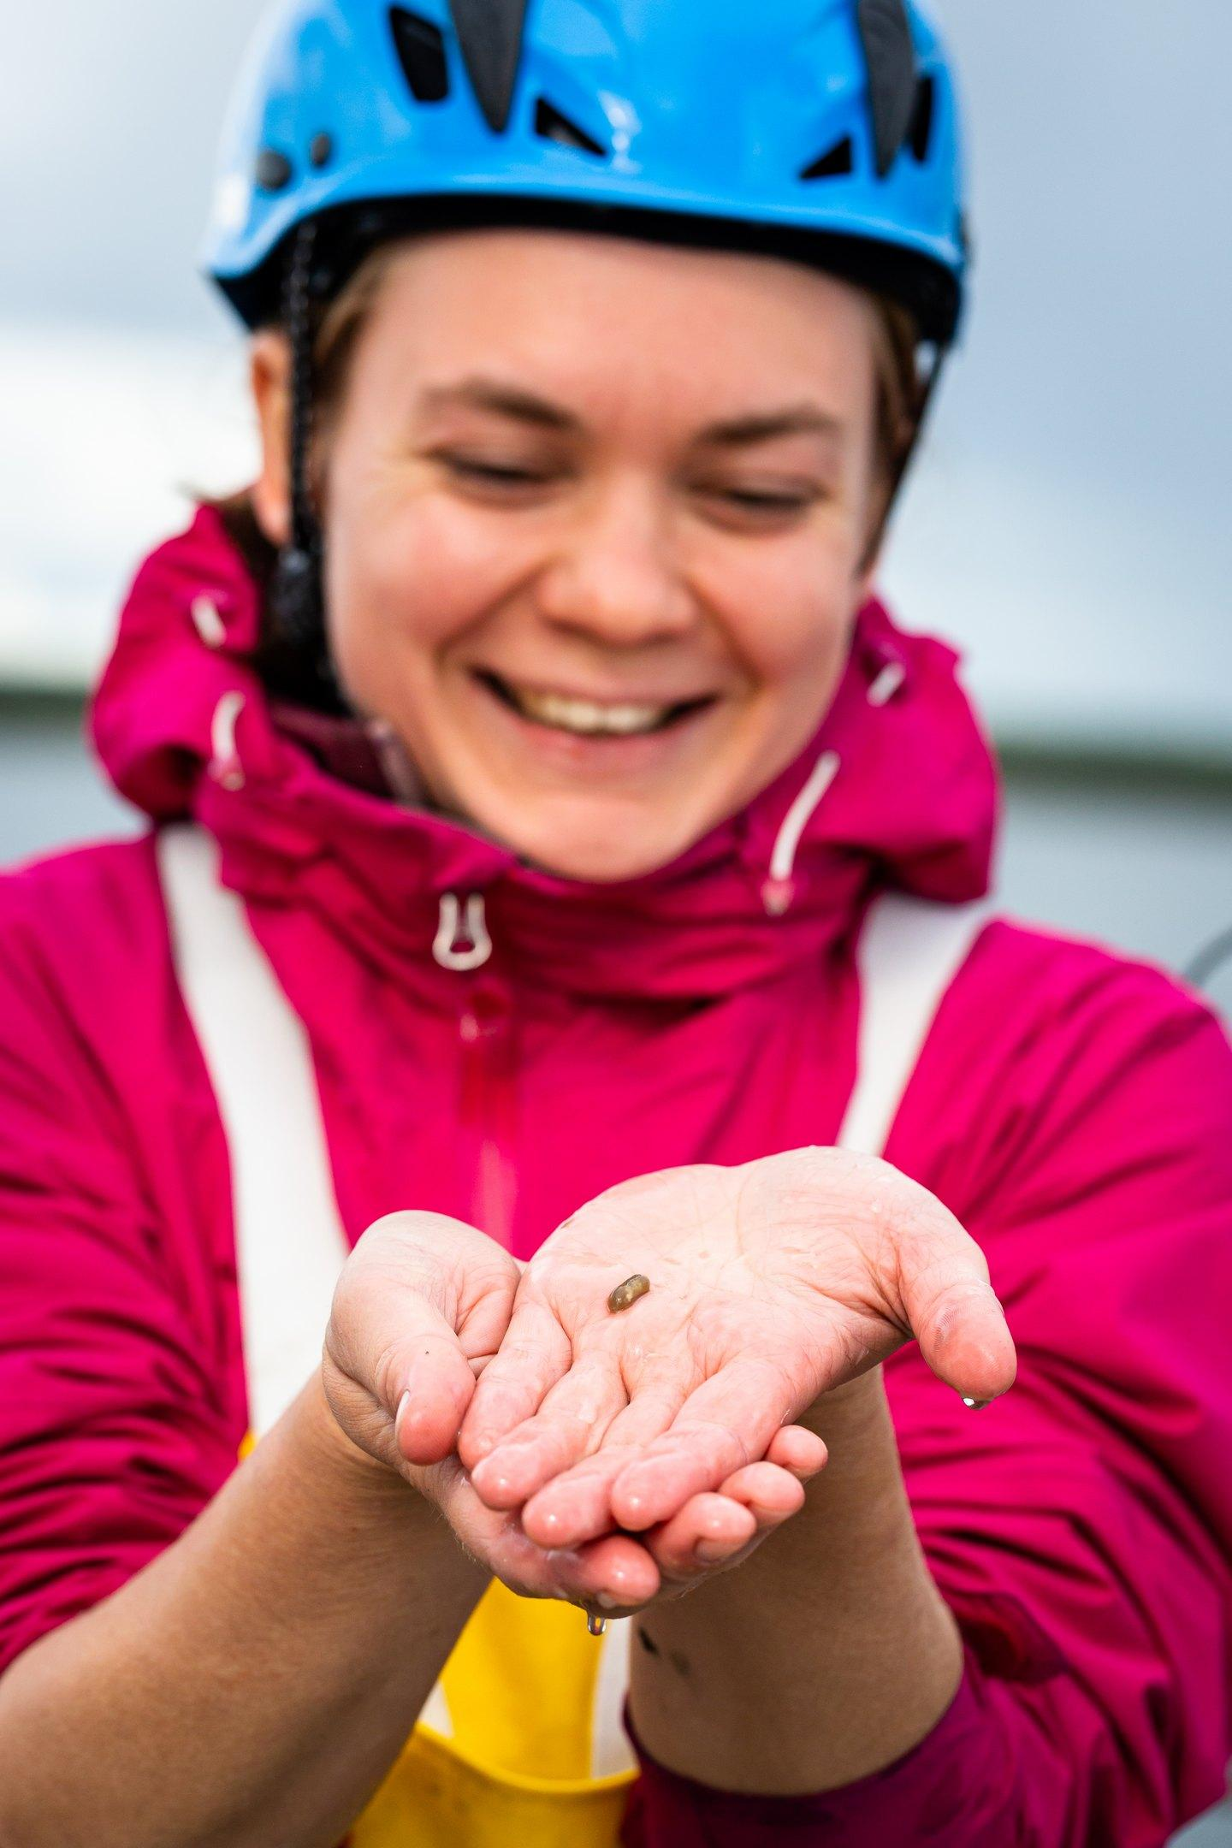
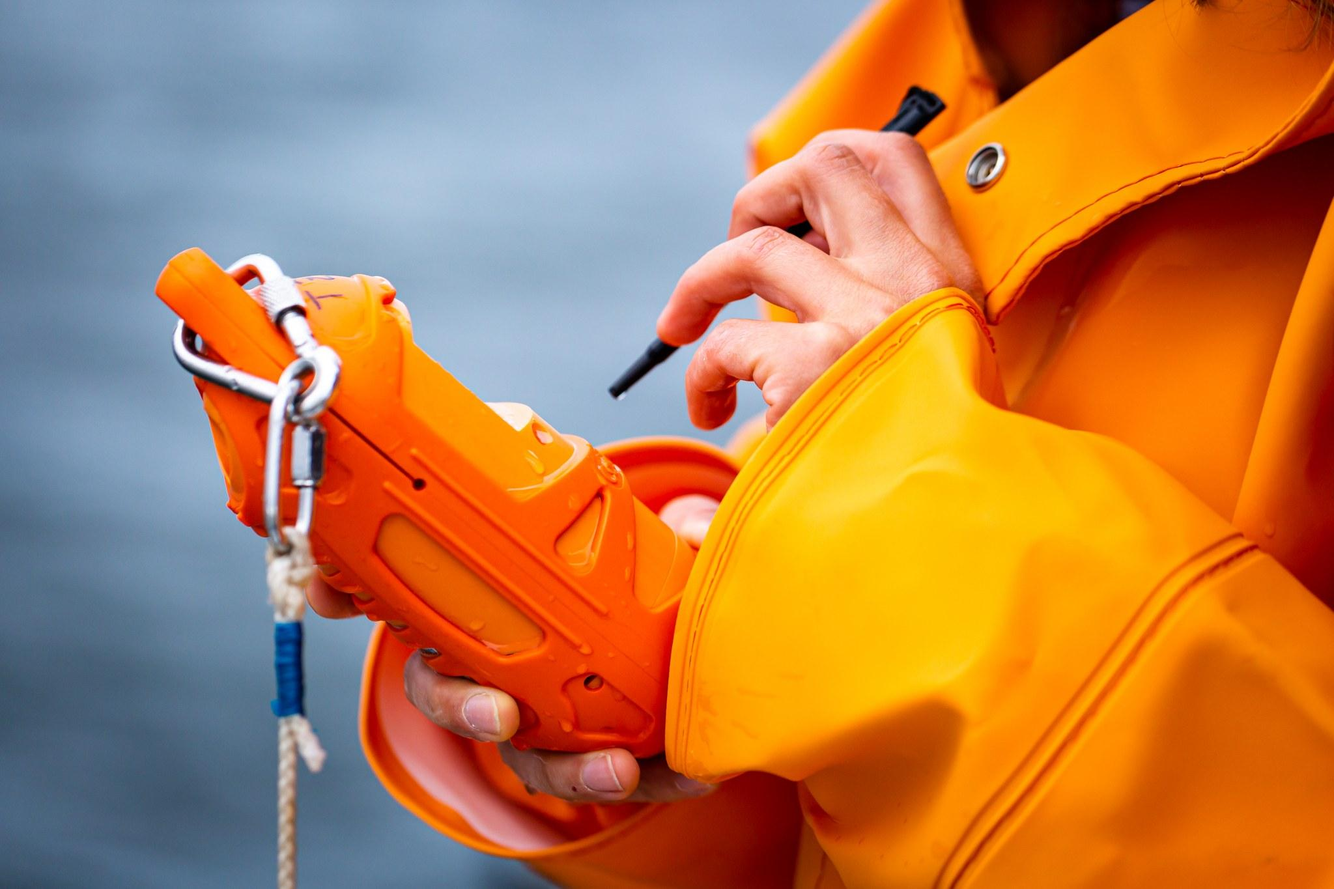
EXPERIENCE LIFE AT A FIELD STATION.
You will stay for 5 days at Tvärminne Zoological Station in an international surrounding with marine researchers from all over the world.
Expect to be outdoors a lot, this is a practical course and you need to gear up accordingly.
Bring a good mood and prepare to learn a lot of new stuff.
Take this unique opportunity to gain an insight into cutting edge science. This is where the knowledge of tomorrow is created.
Learn about different ways of studying natural sciences in Finland and abroad.

Slide 5
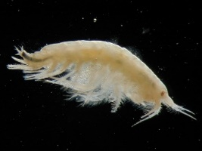
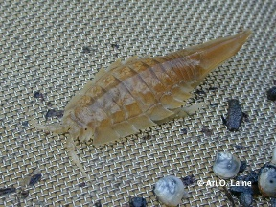
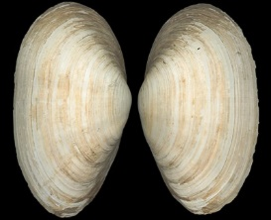
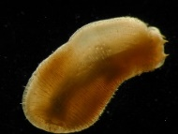
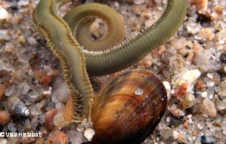
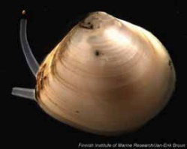
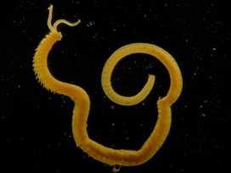
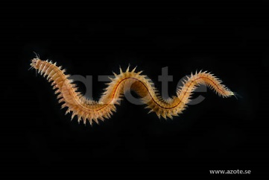
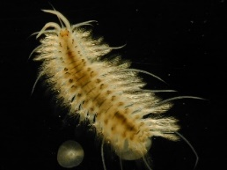
WHAT WILL YOU LEARN?
To use scientific methods to measure and compare marine biodiversity.
To identify aquatic plants (macrophytes) in the sea and learn how to measure them in numbers.
To identify species living at the seafloor (benthic fauna), and to calculate their abundance and biomass.
To estimate carbon stocks at contrasting coastal sites.
To understand dynamic functions like oxygen production and respiration in the marine environment.
How to use field equipment and handle samples.
To analyse results and to write a scientific report.

Slide 6
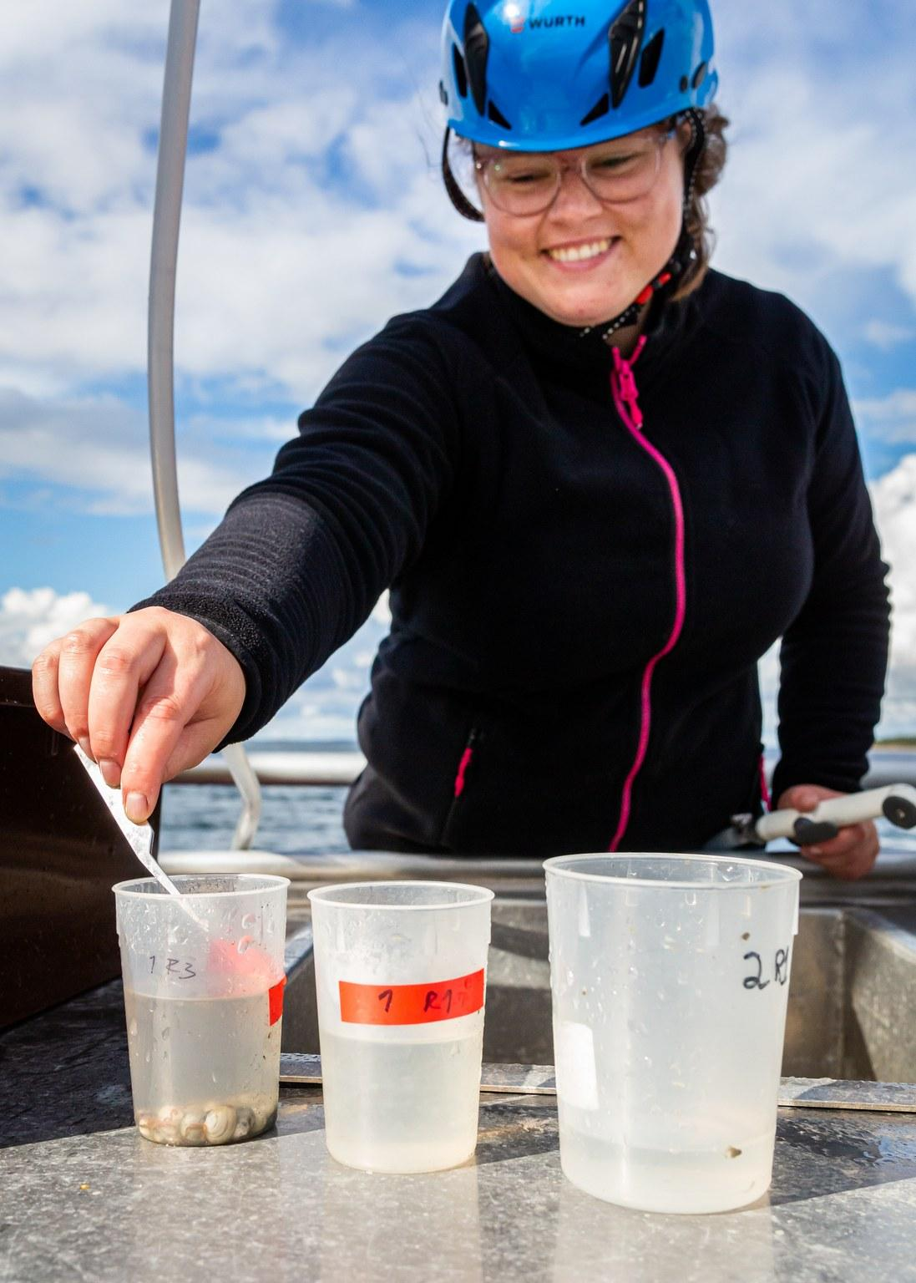
FACTS ABOUT THE COURSE FROM THE SCHOOLS!
The course is open for students from Hangö gymnasium, Hankoniemen lukio, Karis-Billnäs gymnasium, Ekenäs gymnasium and Karjaan lukio
The main language is Swedish and Finnish but some of the teachers will also speak English.

